Slide 1
DATA VISUALIZATION PROJECT
MIS376
ORUÇ HAN KURAL
17030411047

Slide 2
INTRODUCTION
States, which are created to protect people’s health, security and other rights, have sometimes been the cause of or solutions to these disasters.

Slide 3
COVID-19 PANDEMIC AND EDUCATION
More than 1 billion children are at risk of falling behind due to school closures aimed at containing the spread of COVID-19. To keep the world’s children learning, countries have been implementing remote education programs.

Slide 4
SCHOOL CLOSURES
With school closures across 188 countries (as of April 2020), many of them are exploring alternative ways to provide continuous education using technologies such as Internet, TV, and radio.

Slide 5
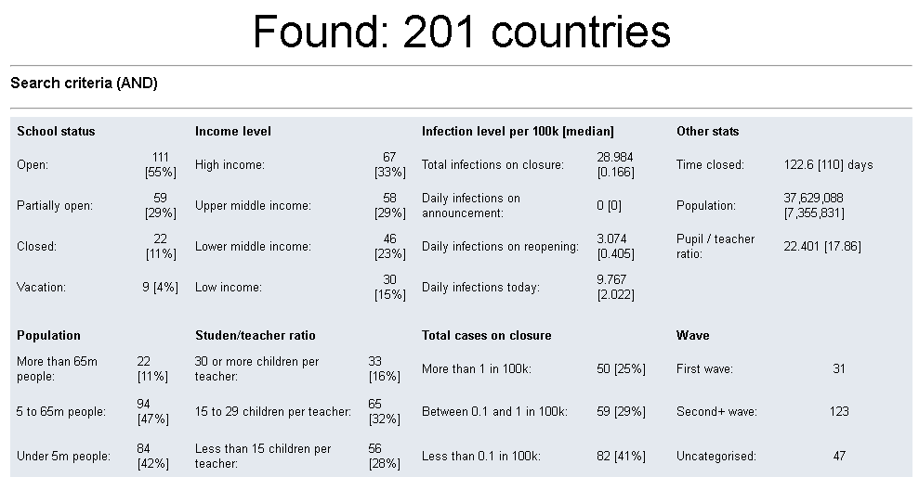
COUNTRIES AND EDUCATION STATUS

Slide 6
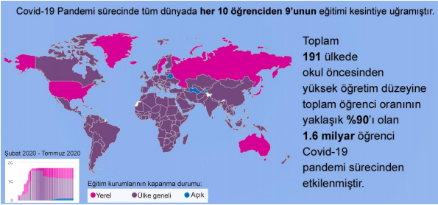
AFFECTED UNIVERSITY AND OTHER STUDENT BY PANDEMI
In this chart, we observe the number of students affected by the pandemic process worldwide

Slide 7
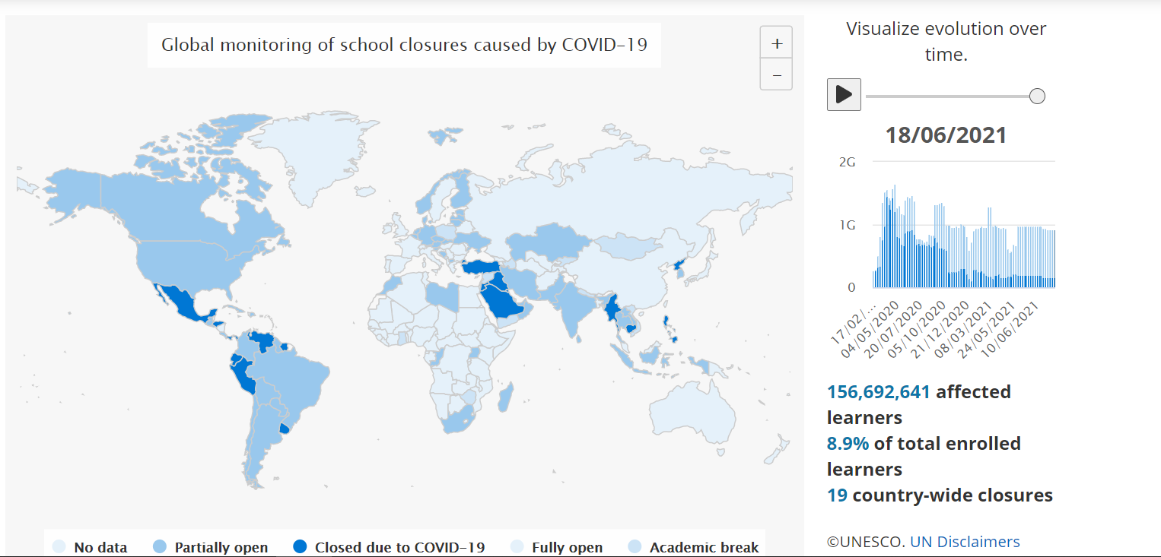
COUNTRIES & CLOSES ENSUREMENT
The report uses two major data sources: UNESCO’s monitoring of school closures (UNESCO, 2021), and the UIS database on student populations (UNESCO UIS, 2021).

